Slide 1

Hyperledger
Technical Working Group China
2021.5

Slide 2

Scope
Technical Working Group Chain(TWGC, 中国工作组) is the first region-based working group, TWGC is responsible for growing the Hyperledger developer community in China by responding to new user questions, helping with first-level triage of community-reported bugs or other issues, helping demonstrate to new developers how to report bugs or fire pull requests, and pointing motivated developers towards the project roadmaps and development initiatives at the global Hyperledger web sites. It should also make sure to expose new users to the broad range of projects at Hyperledger.

Slide 3

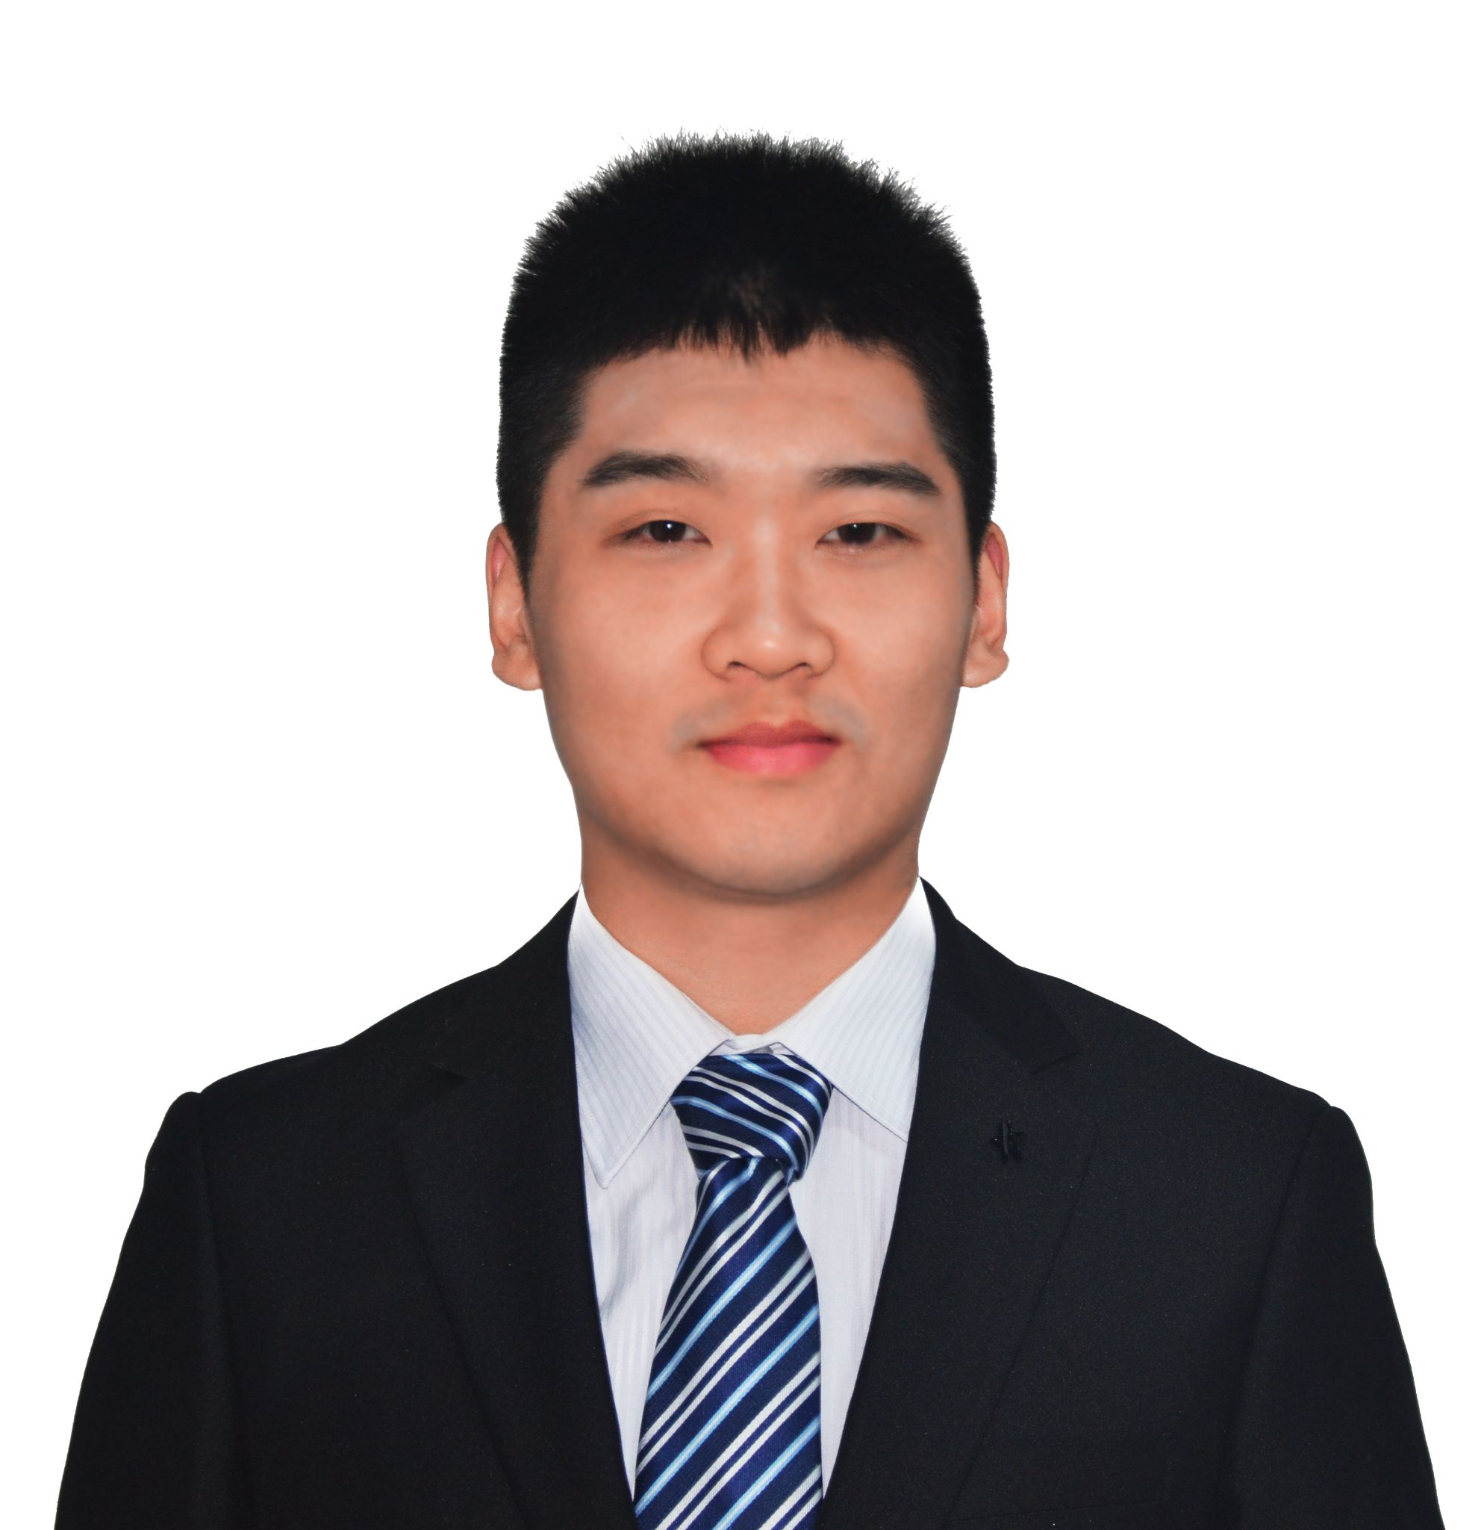

Committee Board
Current chairs were elected in Oct 2020.
刘宇翔(David)
Oracle
程阳(Yang Cheng)
CAICT
郭剑南(Jay Guo)
Rootchain

Slide 4



Working Areas
Localization & Education
Development & Innovation
Collaborations & Scenarios
01
03
Help lead the documentation writing/translation, organize seminar and education/trainings, etc.
02
Help lead the development of hyperledger projects in code, tutorial, demos, with instructions on maillist, rocketchat, etc.
Help encourage the collaborations between organizations and projects, with landing more scenarios/apps

Slide 5
Taskforce
TWGC Committee Board
Performance & Scalability
benchmark tool
paper research
proof of concept
...
GM (China cryptography)
libraries
modular cryptograph at upstream
reference implementation
…
Localization
docs
blogs
whitepapers
...

Slide 6
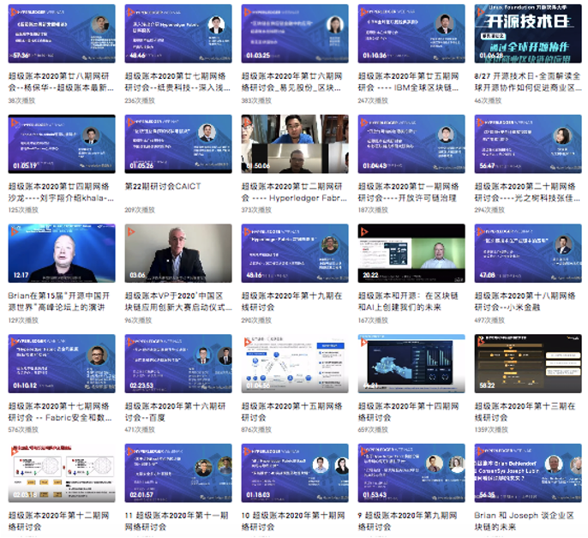
Event Organization
TWGC organizes meetups and webinars regularly
28 webinars were held in 2020 with ~10k views.

Slide 7
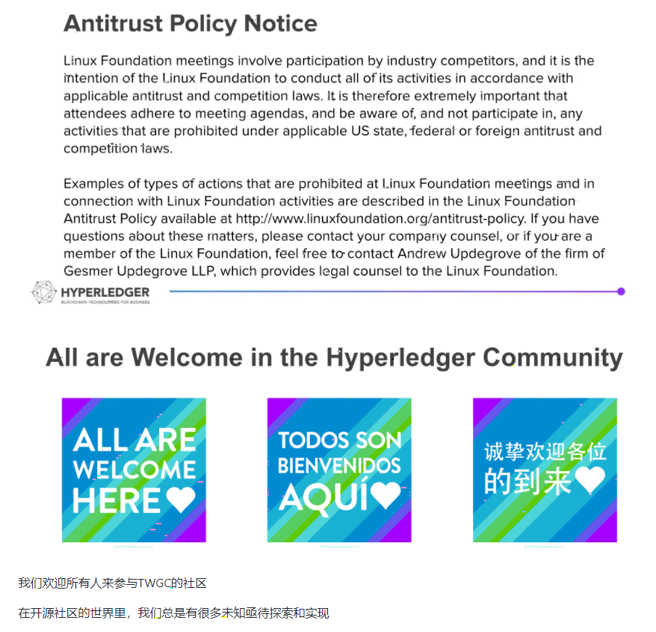
How to participate
All are Welcome!

Slide 8
Communication
01 | Bi-weekly group meeting on Wednesday 20:00~21:00 (GMT+8)
02 | Maillist: twg-china@lists.hyperledger.org
03 | Rocketchat：https://chat.hyperledger.org/channel/twg-china
04 | Wiki: https://wiki.hyperledger.org/display/TWGC
05 | Wechat groups
06 | Code Collaboration: github.com/Hyperledger-TWGC

Slide 9
Good first...
Revive “Collaboration and Scenario”
Hyperledger +, like today
CrossChain TaskForce
Proposal for an event
Revive “PSWG”
Revive “Fabric interopt”
Show your support
Use, Star, Fork, Contribute TWGC code projects
Attend any meeting and let us get familiar
Help project incubating in TWGC

Slide 10
Thank you.

